Slide 1


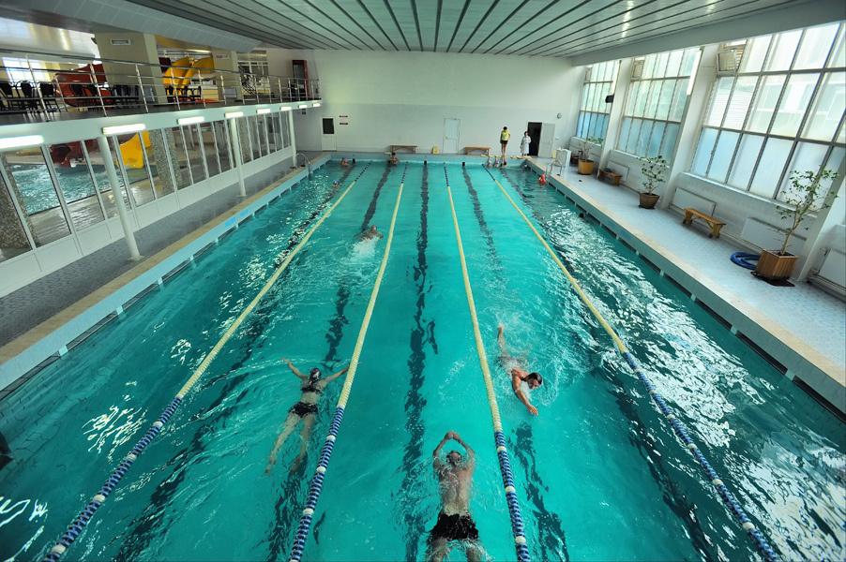
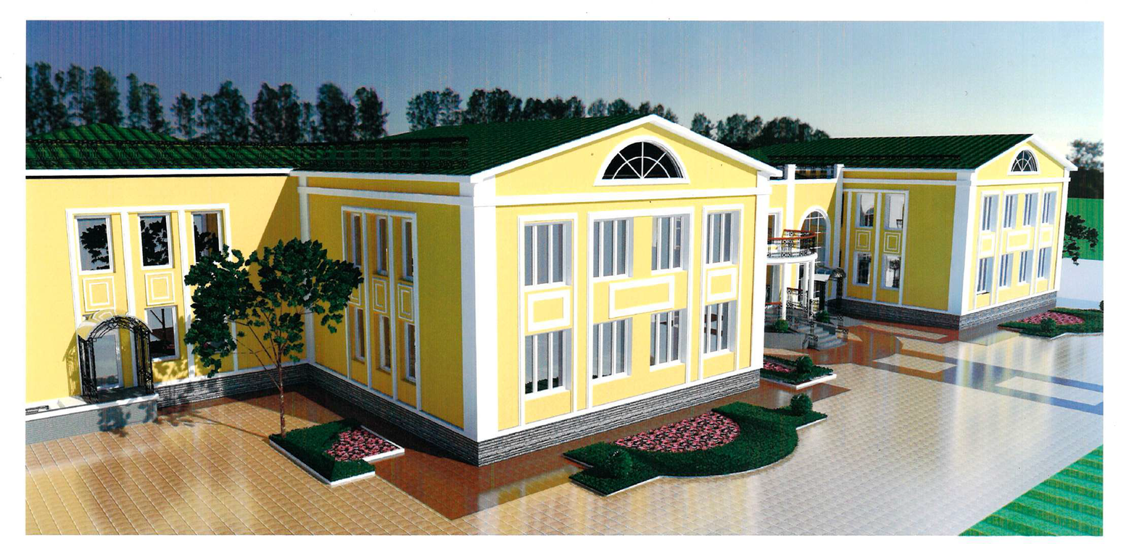
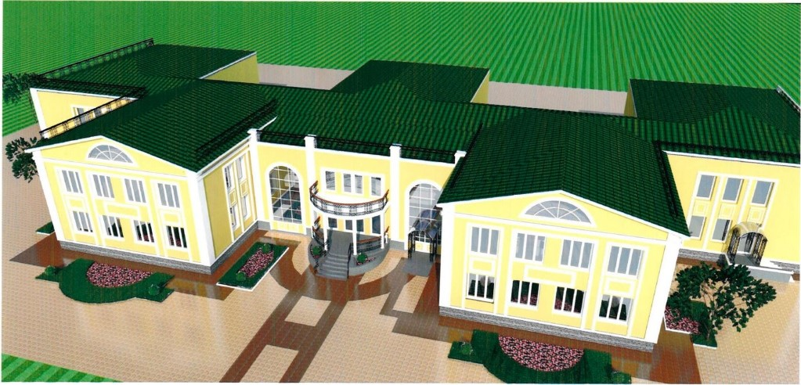



Overhaul of a building for accommodating internally displaced (evacuated) persons and a center for work with internally displaced (evacuated) children

Slide 2
















Overhaul of a building for accommodating internally displaced (evacuated) persons and a center for work with internally displaced (evacuated) children
The project includes the following work:
The project is aimed at:
internally displaced/evacuated persons who, due to unemployment, disability, caring for young children, or advanced age, are unable to rent housing on their own
the potential capacity for residents and staff simultaneously is 145 people
complete replacement of the roof covering
selective remodelling of specific premises
full replacement of windows and door slits
reinstallation of ceiling equipment and new wall treatment
renovation of all porches, including adjustments for accessibility needs of people with limited mobility
insulation of facades
The total cost of the project is
≈ 2 150 000 EUR

Slide 3
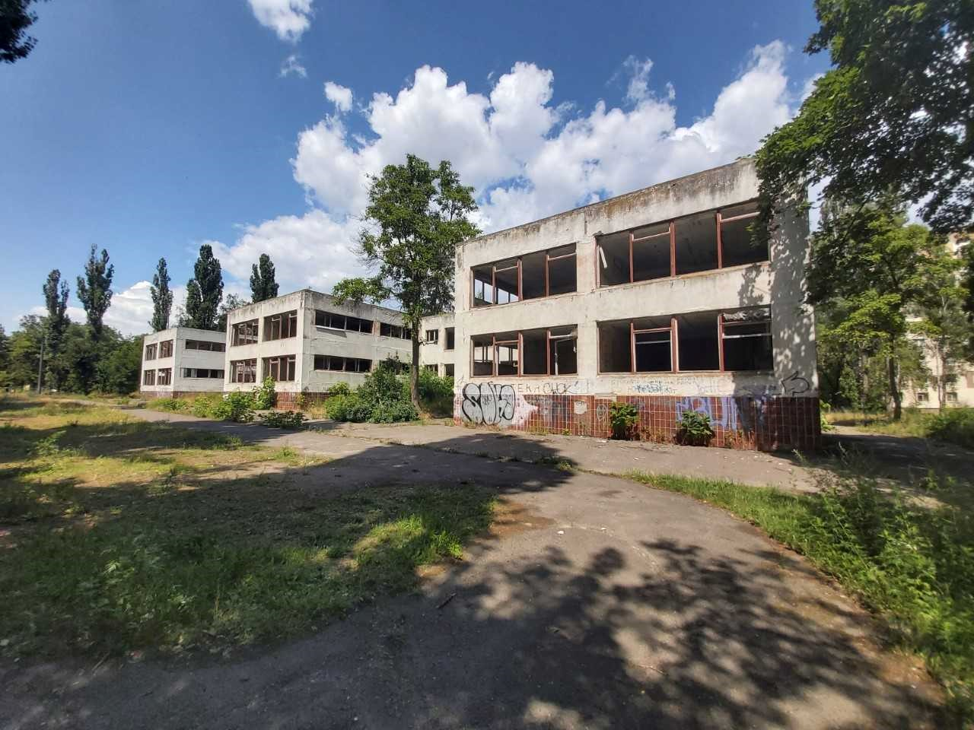


Expected results:
30 individual housing units created for the temporary accommodation of internally displaced (evacuated) persons, including an entryway, hallway, room, kitchen, and combined bathroom.
two educational units set up for the centre for activities with internally displaced/evacuated children

